Slide 1

The Fourth Hour!
Welcome to…

Slide 2
Introduction
Welcome to the Fourth Hour!
Name
Professor
A fun fact about you

Slide 3
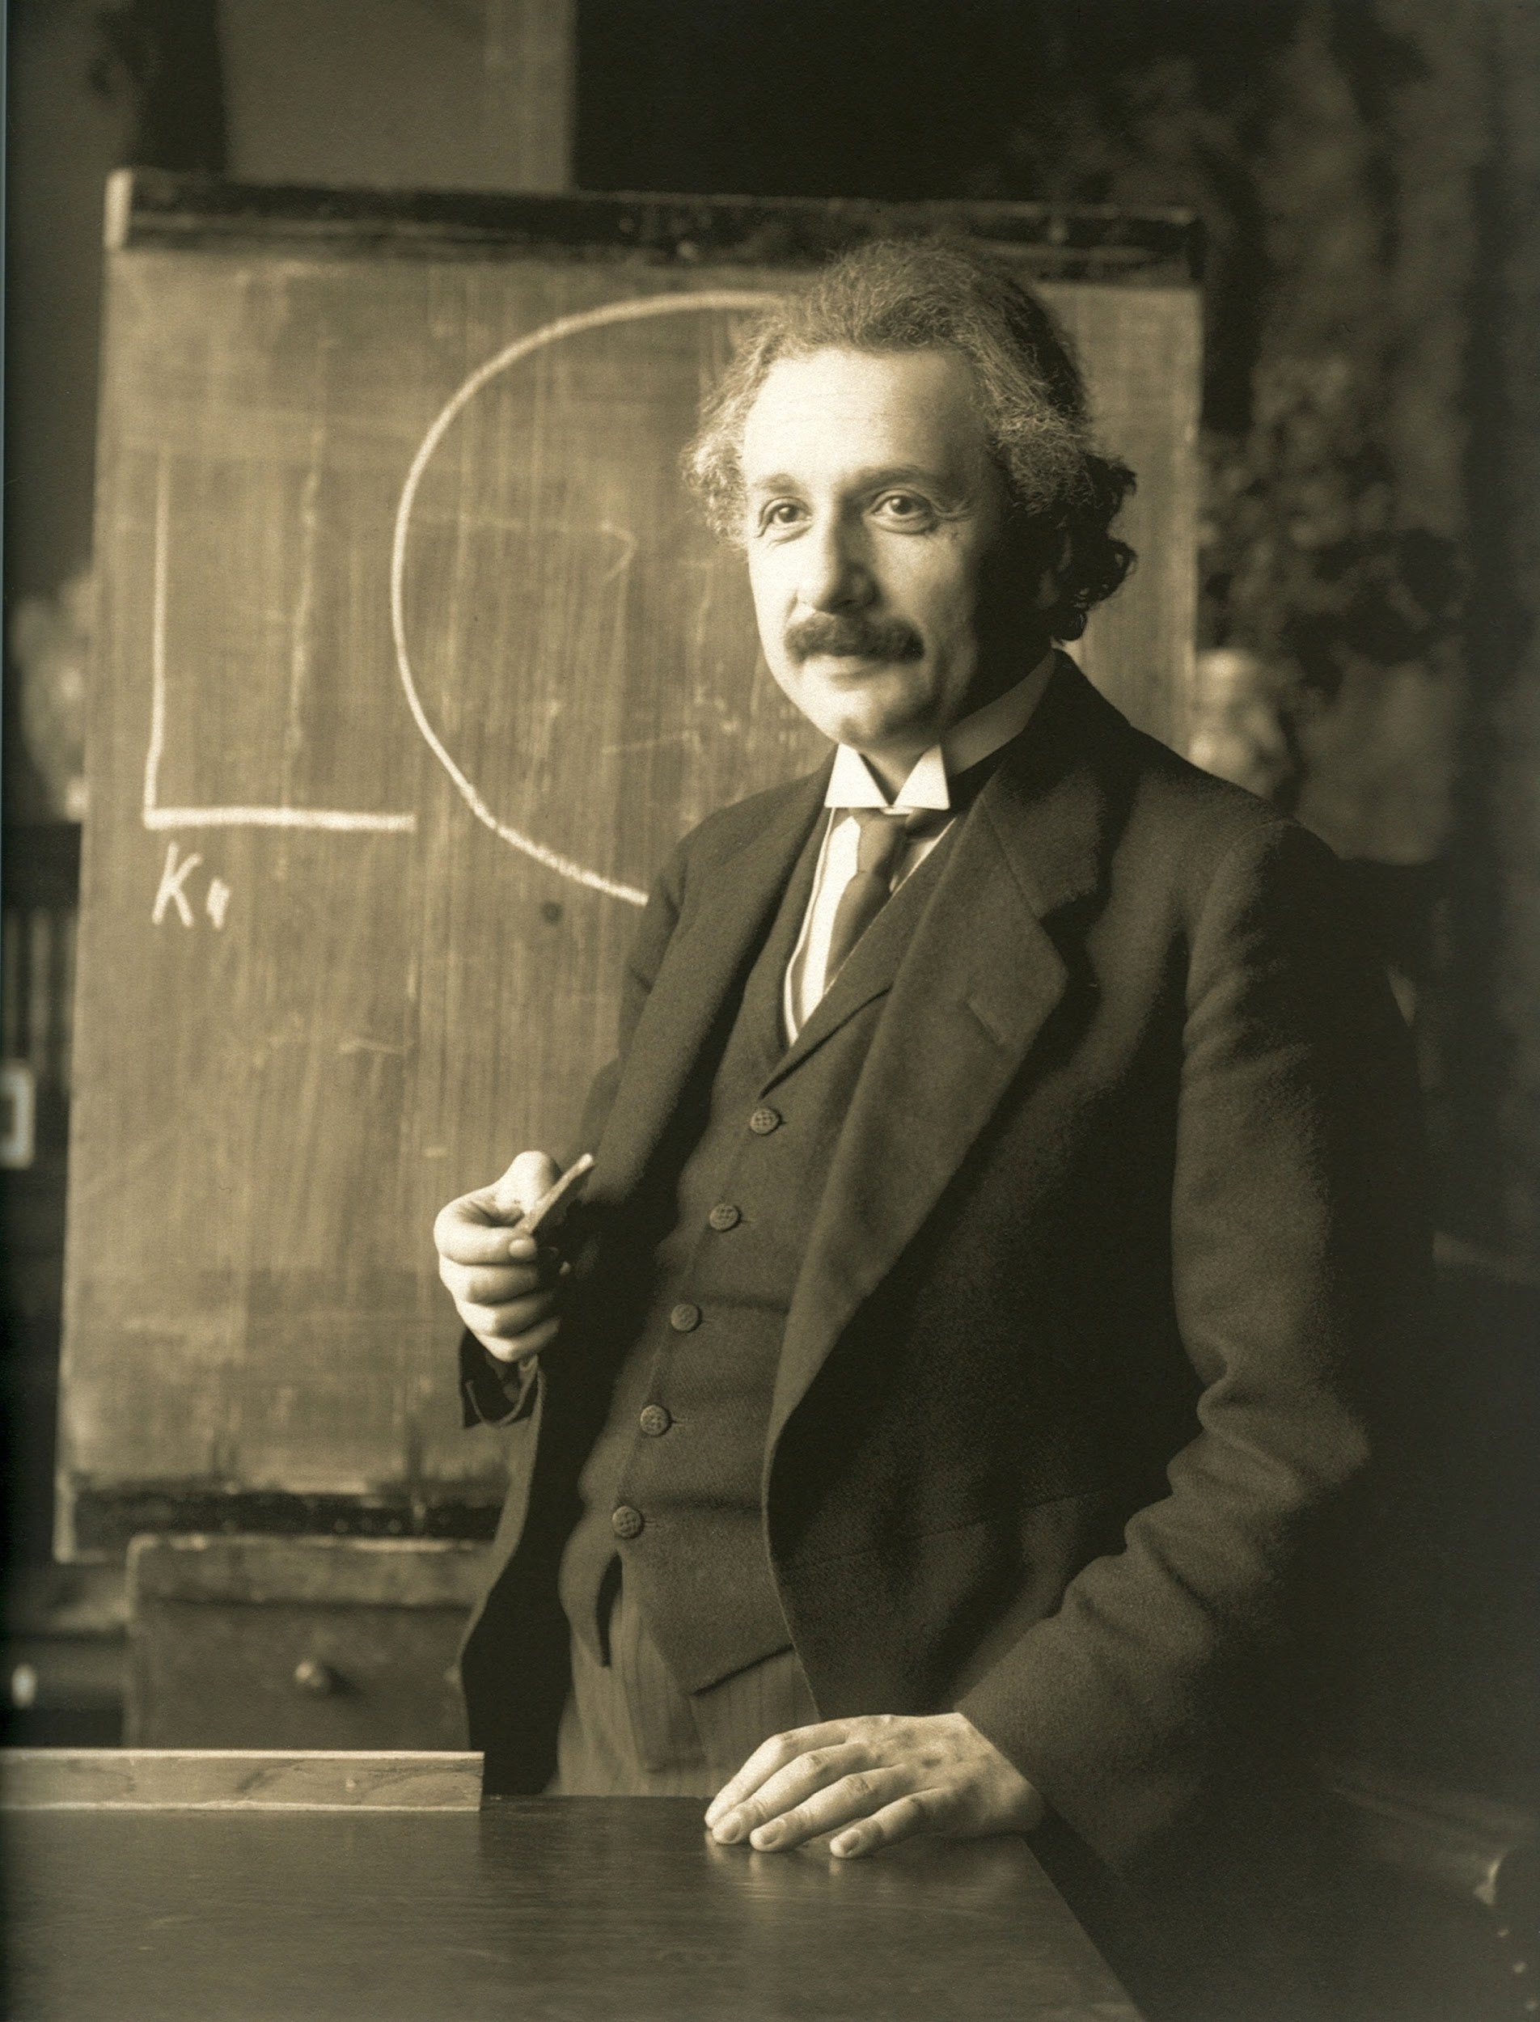
“Anyone who has never made a mistake has never tried anything new.”

Slide 4
Testing code
Coding can sometimes be tricky and it can be hard to find bugs in code
Writing/Brainstorming possible test cases before coding can actually help finding an accurate solution quickly
Why?

Slide 5
Testing code
Coding can sometimes be tricky and it can be hard to find bugs in code
Writing/Brainstorming possible test cases before coding can actually help finding an accurate solution quickly
Why?
We get a better understanding of what we want our functions to do or return given certain input

Slide 6
How do we know what test cases we need
First read the assignment specifications (specs)
This way we know the intended behavior

Slide 7
How do we know what test cases we need
First read the assignment specifications (specs)
This way we know the intended behavior
Look for boundaries and test at boundary points
Ex. The user is only allowed to input a number between and inclusive 0-100.

Slide 8
How do we know what test cases we need
First read the assignment specifications (specs)
This way we know the intended behavior
Look for boundaries and test at boundary points
Ex. The user is only allowed to input a number between and inclusive 0-100.
Write a test for outside lower boundary ( ex. -1)
Write a test for outside upper boundary (ex. 101)
Write a test for low boundary - 0
Write a test for high boundary - 100
Write a test for normal operation - 35

Slide 9
How do we know what test cases we need
First read the assignment specifications (specs)
This way we know the intended behavior
Look for boundaries and test at boundary points
Ex. The user is only allowed to input a number between and inclusive 0-100.
Write a test for outside lower boundary ( ex. -1)
Write a test for outside upper boundary (ex. 101)
Write a test for low boundary - 0
Write a test for high boundary - 100
Write a test for normal operation - 35
Look for inputs that result in different behavior
Ex. If the input is negative print out “Alert!”

Slide 10
How do we know what test cases we need
First read the assignment specifications (specs)
This way we know the intended behavior
Look for boundaries and test at boundary points
Ex. The user is only allowed to input a number between and inclusive 0-100.
Write a test for outside lower boundary ( ex. -1)
Write a test for outside upper boundary (ex. 101)
Write a test for low boundary - 0
Write a test for high boundary - 100
Write a test for normal operation - 35
Look for inputs that result in different behavior
Ex. If the input is negative print out “Alert!”
Write a test for any negative number
Also write a test for any positive number (make sure “Alert” is not printed)

Slide 11
Review
Login to Socrative at https://b.socrative.com/login/student/
Use code 4thHour149

Slide 12
Question 1
Given a function called foo that takes in a parameter named x. When x is divisible by 3 return the string “foo”. When x is divisible by 5 return “bob”. When x is divisible by both 5 and 3 return the string “foobob”. If none of the conditions pass return an empty string.
What is the best set of test cases from the choices below for this problem?
In other words, what numbers should we test with this method?
1, 2, 3, 4, 5, 6, 7, 8, 9, 10, … 100
2, 4, 6, 8, 10, 12
3, 5, 10, 2
3, 5, 15, 4
9, 10, 3, 5
5, 3, 15
Notes:
C) is incorrect b/c we do not have a condition in which a number is divisible by both 5 and 3.
Differing behavior cases are being checked in this case. Each case above will result in a different return value.

Slide 13
Question 1
Given a function called foo that takes in a parameter named x. When x is divisible by 3 return the string “foo”. When x is divisible by 5 return “bob”. When x is divisible by both 5 and 3 return the string “foobob”. If none of the conditions pass return an empty string.
What is the best set of test cases from the choices below for this problem?
In other words, what numbers should we test with this method?
1, 2, 3, 4, 5, 6, 7, 8, 9, 10, … 100
2, 4, 6, 8, 10, 12
3, 5, 10, 2
3, 5, 15, 4
9, 10, 3, 5
5, 3, 15
Notes:
C) is incorrect b/c we do not have a condition in which a number is divisible by both 5 and 3.
Differing behavior cases are being checked in this case. Each case above will result in a different return value.

Slide 14
How do we write test cases?
We can write test cases several ways:
The first way is to print the results of function calls in our program, either in a main function or any place in the program.

Slide 15
How do we write test cases?
We can write test cases several ways:
The first way is to print the results of function calls in our program, either in a main function or any place in the program.
For example:
print(“foo test with value 3 was:”, foo(3))
print(“Expected the value to be: foo”)

Slide 16
What we have been doing…
print(“foo test with value 5:”, foo(5)) print (“Expected the value to be: bob”)
print(“foo test with value 15:”, foo(15)) print(“Expected the value to be: foobob”)
print(“foo test with value 4:”, foo(4)) print(“Expected the value to be: ”)

Slide 17
Testing with AssertEquals
Let’s write some tests with AssertEquals for this method, here is an example.
def test_foo(self):
self.assertEqual(“foo”, foo(3))

Slide 18
Testing with AssertEquals
Let’s write some tests with AssertEquals for this method, here is an example.
def test_foo(self):
self.assertEqual(“foo”, foo(3))
self.assertEqual(“foobob”, foo(15))
self.assertEqual(“bob”, foo(5))
self.assertEqual(“”, foo(4))

Slide 19
Methods to test…
def exclamation(word):
return (word + "!")
def question(word):
return (word + "?")
Notes:
boundary cases, testing with a main, fill in the blank socrative questions

Slide 20
Methods to test…
def exclamation(word):
return (word + "!")
def question(word):
return (word + "?")
def test_exclamation(self):
expected = “Thanks!”
actual = exclamation(“Thanks”)
self.assertEqual(expected, actual)
Notes:
boundary cases, testing with a main, fill in the blank socrative questions

Slide 21
Methods to test…
def exclamation(word):
return (word + "!")
def question(word):
return (word + "?")
def test_exclamation(self):
expected = “Thanks!”
actual = exclamation(“Thanks”)
self.assertEqual(expected, actual)
def test_question(self):
expected = “Thanks?”
actual = exclamation(“Thanks”)
self.assertEqual(expected, actual)
Notes:
boundary cases, testing with a main, fill in the blank socrative questions

Slide 22
Methods to test… (Shorthand)
def exclamation(word):
return (word + "!")
def question(word):
return (word + "?")
def test_exclamation(self):
self.assertEqual(“Thanks!”, exclamation(“Thanks”))
def test_question(self):
self.assertEqual(“Thanks?”, exclamation(“Thanks”))
Notes:
boundary cases, testing with a main, fill in the blank socrative questions

Slide 23
Question 2 - PI
(1): max([1, 2, 3, 4])
(2): 4
(1): 4
(2): max([1, 2, 3, 4])
(1): max(4)
(2): [1, 2, 3, 4]
(1): [1, 2, 3, 4]
(2): max(4)
Given the function max that takes a list
and finds the max, fill in the blanks to
write the unittest.
def test_max(self):
expected = (1)
actual = (2)
self.assertEqual(expected, actual)

Slide 24
Question 2 - PI
(1): max([1, 2, 3, 4])
(2): 4
(1): 4
(2): max([1, 2, 3, 4])
(1): max(4)
(2): [1, 2, 3, 4]
(1): [1, 2, 3, 4]
(2): max(4)
Given the function max that takes a list
and finds the max, fill in the blanks to
write the unittest.
def test_max(self):
expected = (1)
actual = (2)
self.assertEqual(expected, actual)

Slide 25
Testing with main…
def exclamation(word):
return (word + "!")
def question(word):
return (word + "?")
def main():
???
???

Slide 26
Testing with main…
def exclamation(word):
return (word + "!")
def question(word):
return (word + "?")
def main():
print(exclamation(“Thanks”))
???

Slide 27
Testing with main…
def exclamation(word):
return (word + "!")
def question(word):
return (word + "?")
def main():
print(exclamation(“Thanks”))
print(question(“Thanks”))

Slide 28
Testing with main…
def exclamation(word):
return (word + "!")
def question(word):
return (word + "?")
def main():
print(exclamation(“Thanks”))
print(question(“Thanks”))
Thanks!
Thanks?

Slide 29
Question 3 - PI
Given the function ageChecker that takes a single int paramager age and returns 0 if age is [0-20], 1 if age is [21-60], 2 if age is 61+, and -1 if age is <0…
What would be the best set of test cases to use?
-1, 0, 1, 2
0, 1, 2
-10, 0, 21, 65
-10, 0, 15, 20, 85

Slide 30
Question 3 - PI
Given the function ageChecker that takes a single int paramager age and returns 0 if age is [0-20], 1 if age is [21-60], 2 if age is 61+, and -1 if age is <0…
What would be the best set of test cases to use?
-1, 0, 1, 2
0, 1, 2
-10, 0, 21, 65
-10, 0, 15, 20, 85

Slide 31
Making More Test Cases
Given the function ageChecker that takes a single int parameter age and returns 0 if age is [0-20], 1 if age is [21-60], 2 if age is 61+, and -1 if age is <0…
Okay, let’s use asserts to test the function with these test cases: -10, 0, 21, 65
self.assertEqual(?, ?)

Slide 32
Making More Test Cases
Given the function ageChecker that takes a single int parameter age and returns 0 if age is [0-20], 1 if age is [21-60], 2 if age is 61+, and -1 if age is <0…
Okay, let’s use asserts to test the function with these test cases: -10, 0, 21, 65
self.assertEqual(-1, ?)

Slide 33
Making More Test Cases
Given the function ageChecker that takes a single int parameter age and returns 0 if age is [0-20], 1 if age is [21-60], 2 if age is 61+, and -1 if age is <0…
Okay, let’s use asserts to test the function with these test cases: -10, 0, 21, 65
self.assertEqual(-1, ageChecker(-10)) # (expected, actual)

Slide 34
Making More Test Cases
Given the function ageChecker that takes a single int parameter age and returns 0 if age is [0-20], 1 if age is [21-60], 2 if age is 61+, and -1 if age is <0…
Okay, let’s use asserts to test the function with these test cases: -10, 0, 21, 65
self.assertEqual(-1, ageChecker(-10)) # (expected, actual)
self.assertEqual(0, ageChecker(0))

Slide 35
Making More Test Cases
Given the function ageChecker that takes a single int parameter age and returns 0 if age is [0-20], 1 if age is [21-60], 2 if age is 61+, and -1 if age is <0…
Okay, let’s use asserts to test the function with these test cases: -10, 0, 21, 65
self.assertEqual(-1, ageChecker(-10)) # (expected, actual)
self.assertEqual(0, ageChecker(0))
self.assertEqual(1, ageChecker(21))

Slide 36
Making More Test Cases
Given the function ageChecker that takes a single int parameter age and returns 0 if age is [0-20], 1 if age is [21-60], 2 if age is 61+, and -1 if age is <0…
Okay, let’s use asserts to test the function with these test cases: -10, 0, 21, 65
self.assertEqual(-1, ageChecker(-10)) # (expected, actual)
self.assertEqual(0, ageChecker(0))
self.assertEqual(1, ageChecker(21))
self.assertEqual(2, ageChecker(65))

